Slide 1
LEAPP Presentation to the School Committee
Lead Educate and Promote the Profession
September 7, 2017

Slide 3
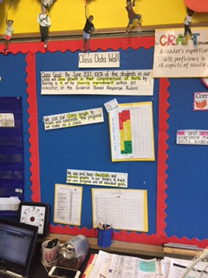

Slide 4
Barrington High School Data
 | Fall 2016 Observed | Fall 2016 Not Observed | Spring 2017 Observed | Spring 2017 Not Observed
I Can Statements Posted | 27% | 63% | 85% | 15%
Student I Cans | 14% | 86% | 52% | 48%
Reference I Cans | 49% | 51% | 63% | 37%
Whole Class Data Posted | 14% | 86% | 36% | 64%
Individual Data Posted | 14% | 86% | 39% | 61%
Student Data Folios | 4% | 96% | 12% | 88%
Reflection | 0% | 100% | 5% | 95%

Slide 5
Barrington Middle School Data
 | Fall 2016 Observed | Fall 2016 Not Observed | Spring 2017 Observed | Spring 2017 Not Observed
I Can Statements Posted | 59.1% | 40.9% | 80% | 20%
Student I Cans | 11.4% | 88.6% | 15% | 85%
Reference I Cans | 14% | 86% | 15% | 85%
Whole Class Data Posted | 37% | 63% | 40% | 60%
Individual Data Posted | 2% | 98% | 15% | 85%
Student Data Folios | 16% | 84% | 13% | 87%

Slide 6
Hampden Meadows School Data
 | Fall 2016 Observed | Fall 2016 Not Observed | Spring 2017 Observed | Spring 2017 Not Observed
I Can Statements Posted | 68% | 32% | 83% | 17%
Mission | 38% | 62% | 70% | 30%
Class Goals | 23% | 67% | 40% | 60%
Individual Goals | 29% | 71% | 48% | 52%
Teacher Data Folio | 16% | 84% | 17% | 83%
Student Data Folios | 41% | 59% | 60% | 40%
Visible Learning Strategies | 22% | 78% | 47% | 53%

Slide 7
Nayatt School Data
 | Fall 2016 Observed | Fall 2016 Not Observed | Spring 2017 Observed | Spring 2017 Not Observed
I Can Statements Posted | 100% | 0% | 100% | 0%
Mission | 38% | 62% | 70% | 30%
Class Goals | 50% | 50% | 100% | 0%
Class Data | 68% | 32% | 81% | 29%
Norms | 90% | 10% | 90% | 10%

Slide 8
Primrose Hill School Data
 | Fall 2016 Observed | Fall 2016 Not Observed | Spring 2017 Observed | Spring 2017 Not Observed
I Can Statements Posted | 60% | 40% | 62% | 38%
Mission | 15% | 85% | 91% | 9%
Class Data | 5% | 95% | 10% | 90%
Individual Data | 5% | 95% | 10% | 90%
Student Tracking | 5% | 95% | 10% | 90%

Slide 9
Sowams School Data
 | Fall 2016 Observed | Fall 2016 Not Observed | Spring 2017 Observed | Spring 2017 Not Observed
I Can Statements Posted | 67% | 33% | 83% | 17%
Mission | 44% | 56% | 75% | 25%
Class Data | 0% | 100% | 0% | 100%
Individual Data | 0% | 100% | 6% | 94%
Student Tracking | 0% | 100% | 30% | 70%

Slide 10
What Comes Next?
Each school creates their strategic goal based on the end of year data
Example plan from 2017
Paula and Morissett and Eliza Pyliotis coach principals and teacher leadership teams using quarterly walkthrough data

Slide 11
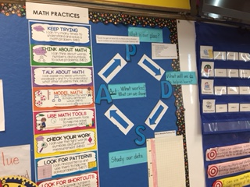

Slide 12
Questions

